Slide 1
CS 5600
Computer Systems
Lecture 11: Virtual Machine Monitors

Slide 2
History
In the ‘70s, there were dozens of OSes
  Unlike today, where Windows and Android dominate
This created many problems
  Upgrading hardware or switching hardware vendors meant changing OS
  However, apps are typically bound to a particular OS
Virtual machines were used to solve this problem
  Pioneered by IBM
  Run multiple OSes concurrently on the same hardware
  Heavyweight mechanism for maintaining app compatibility

Slide 3
Terminology
“Virtual machine” is a loaded term
  E.g. Java Virtual Machine refers to a runtime environment (software) that can execute Java bytecode
“VM” is a loaded abbreviation
  JVM (Java Virtual Machine), Virtual Memory
For our purposes, we will talk about Virtual Machine Monitors (VMM)
  VMM is software that allows multiple guest OSes to run concurrent on one physical machine
    Each guest runs on a virtual machine
  VMM is sometimes called a hypervisor

Slide 4
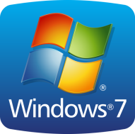
OS Fundamentals
OS multiplexes resources between apps
OS enforces isolation & protection between apps (ring 3)
App
App
App
App
OS
Physical Machine
CPU
RAM
Disks
The OS manages physical resources
The OS expects to have privileged access (ring 0)

Slide 5

VMM Organization and Functions
Map operations on virtual hw. to physical hw.
Multiplex resources between guest OSes
Enforce protection & isolation between guest OSes
App
App
App
App
Guest OS
Guest OS
Virtual Machine
Virtual Machine
CPU
RAM
Disk
VMM
Host OS
Physical Machine
CPU
RAM
Disks

Slide 6
Goals of Virtualization
Popek and Goldberg, 1974
Fidelity: software on the VMM executes identically to its execution on hardware
  Except for timing effects
Performance: An overwhelming majority of guest instructions are executed by the hardware without VMM intervention
  Counterexample: the JVM
Safety: the VMM manages all hardware resources
  Guests cannot impact each other

Slide 7
Advantages of Virtualization (1)
Compatibility and functionality
  Guests are oblivious to low-level hardware changes
  Windows apps on Linux or vice-versa
Consolidation
  Multiple machines can be combined into one by running the OSes as guests
Checkpointing and migration
  A guest OS can be written to disk or sent across the network, reloaded later or on a different machine

Slide 8
Advantages of Virtualization (2)
Security
  If a guest OS is hacked, the others are safe (unless the hacker can escape the guest by exploiting the VMM)
Multiplatform debugging
  App writers often target multiple platforms
    E.g. OS X, Windows, and Linux
  Would you rather debug on three separate machines, or one machine with two guests?

Slide 9
Technical Challenges
x86 is not designed with virtualization in mind
  Some privileged instructions don’t except properly
  MMU only supports one layer of virtualization
These hardware issues violate goal 1 (fidelity)
  As we will discuss, sophisticated techniques are needed to virtualize x86
  These techniques work, but they reduce performance
Modern x86 hardware supports virtualization
  AMD-V and VT-x for hypervisor context switching
  RVI (AMD) and EPT (Intel) for MMU virtualization

Slide 10
Performance Challenges
Memory overhead
  VMM data structures for virtualized hardware may require lots of memory
CPU overhead
  Context switching between VMM and each guest is costly
  Some instructions and functions (e.g. page allocation) must be virtualized; slower than direct operations
I/O performance
  Devices must be shared between guests
  Virtualized devices (e.g. disks, network) may be slower than the underlying physical devices

Slide 11
Full Virtualization (VMWare)
Hardware Support
Paravirtualization (Xen)

Slide 12
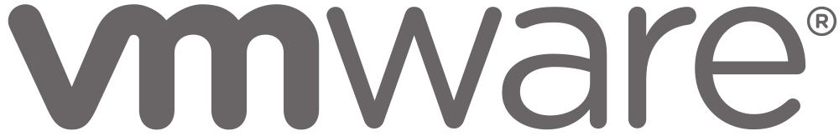
Full Virtualization
VMWare implements full virtualization
  Full → guest OSes do not need to be modified
Goals:
  Run unmodified OSes as guests
  Isolate the guest from the host (safety/security)
  Share physical devices and resources with the guest
    CPU, RAM, disk, network, GPU, etc…
Other full virtualization VMMs:
  Parallels on OS X
  Hyper-v on Windows

Slide 13
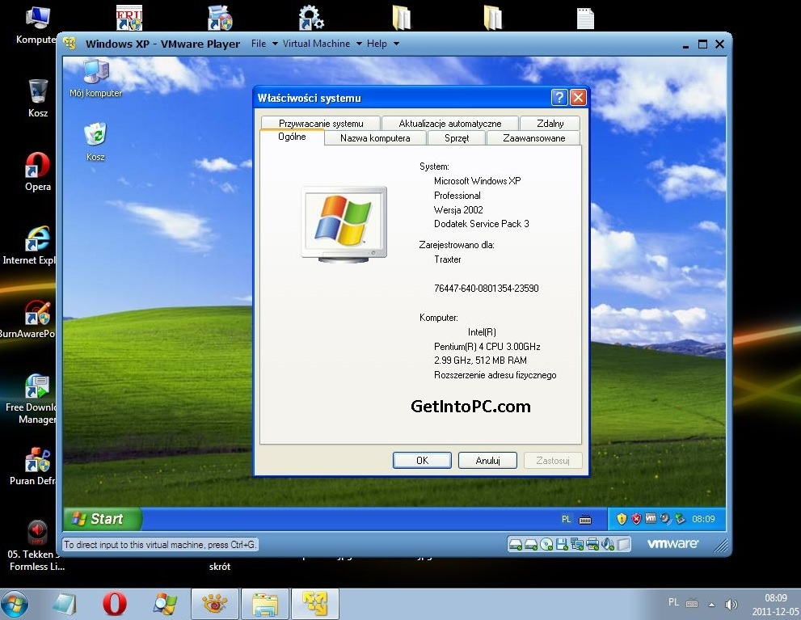

Slide 14
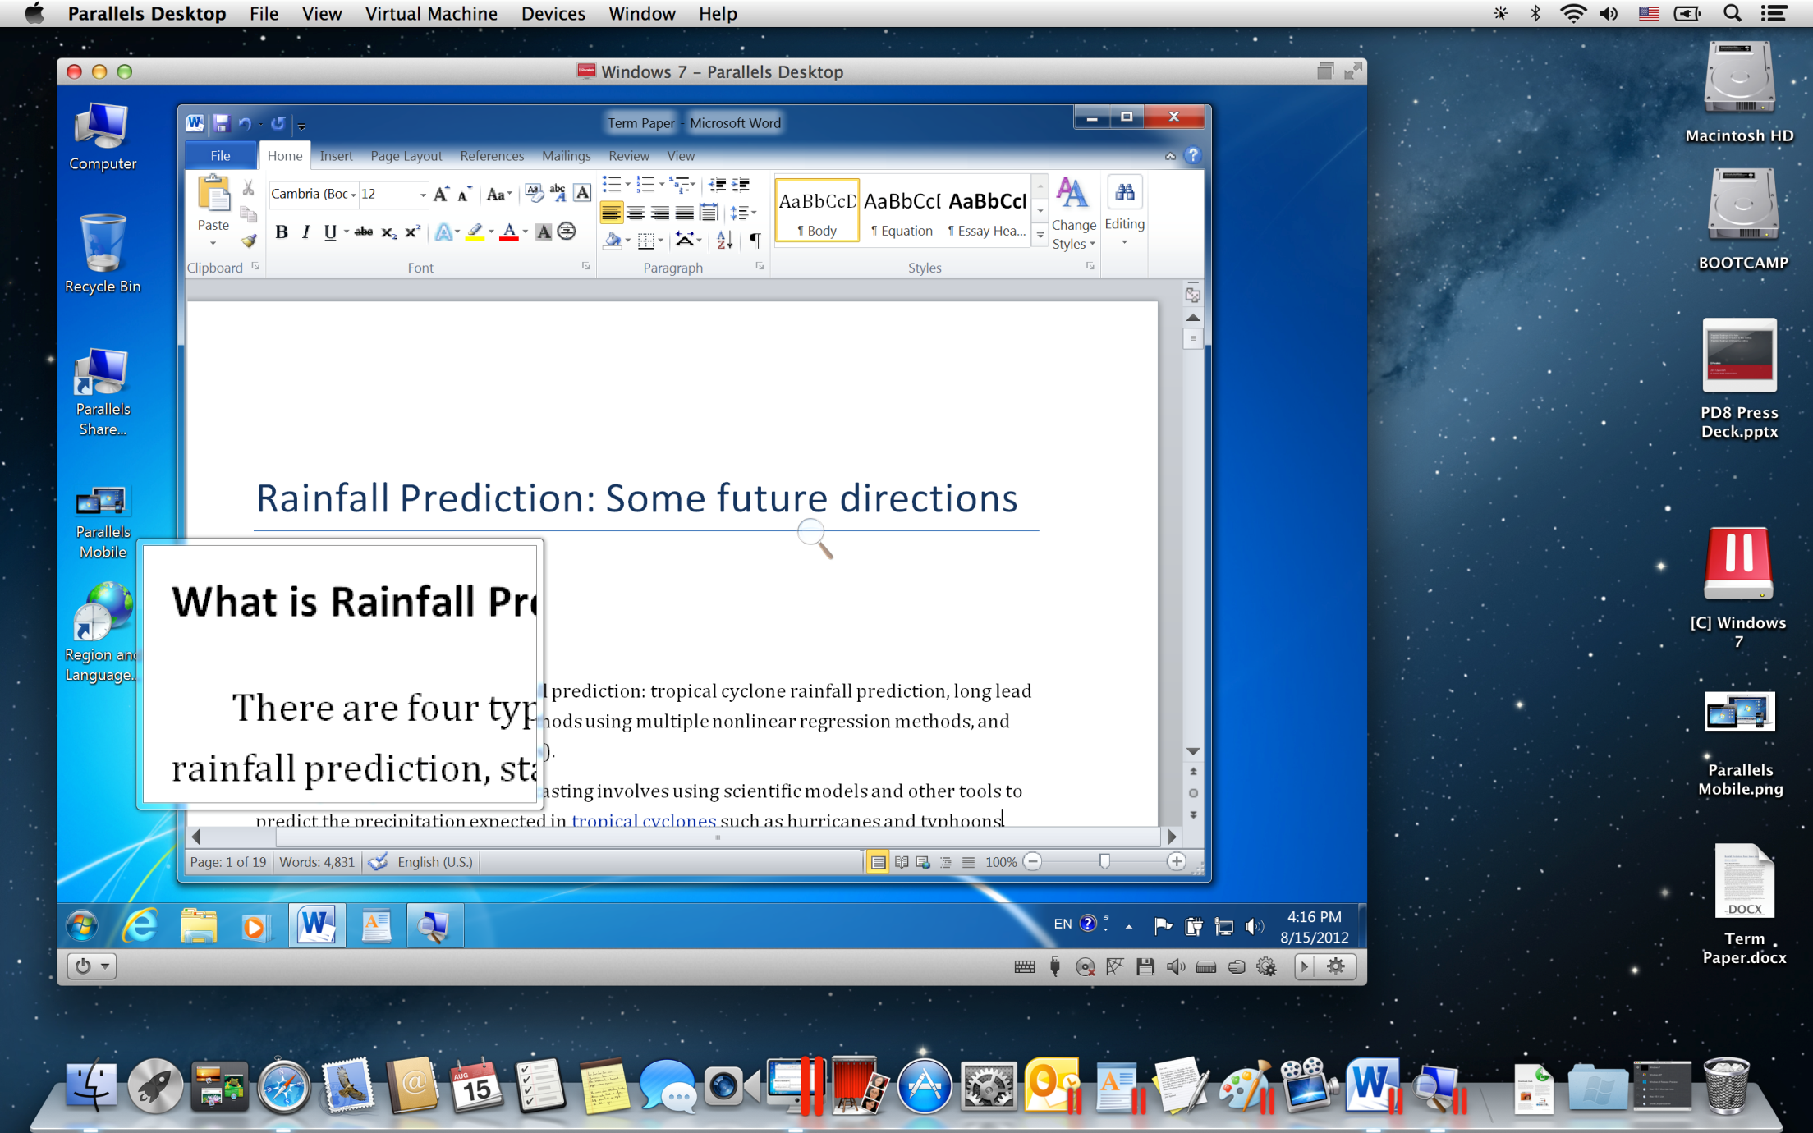

Slide 15
Before We Virtualize…
The VMM is an application
Like any app, it runs on top of a host OS
VMMs exist for most OSes
  VMWare works on Windows and Linux
  Parallels on OS X
  Hyper-V on Windows
Some lightweight OSes are designed to run VMMs
  VMWare ESX
The host OS manages underlying physical resources
VMM
Host OS
Physical Machine

Slide 16
Booting a Guest
When an OS boots, it expects to do so on physical hardware
To boot a guest, the VMM provides virtual hardware
  A fake BIOS
  CPU: typically matches the underlying CPU (e.g. x86 on x86)
  RAM: subset of physical RAM
  Disks: map to subsets of the physical disk(s)
  Network, etc…
Guest OS is totally isolated
  Executes in userland (ring 3)
  Memory is contained in an x86 segment
Guest boots exactly like any other OS
Starts at the MBR, looks for the bootloader, etc…
Guest OS
Virtual Machine
VMM

Slide 17
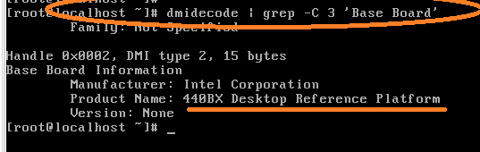
Virtual Machine Hardware
VMMs try to emulate hardware that is:
  Simple
    Emulating advanced features is hard to do in software
  Widely supported by device drivers
    Guests should already include support for the virtual hardware
Example: VMWare virtual motherboard is always an Intel 440BX reference board
This motherboard was released in 1998
Widely supported by many OSes
All VMWare guests run on this virtual hardware to this day

Slide 18
Virtual Hardware Examples
Write to the disk
Send a packet
VMM exports a simple disk interface
  Reads/writes are translated to a virtual filesystem on the real disk
    Just like Pintos on QEMU
Simple network interface
  VMM acts like a NAT, multiplexing packets to and from multiple guests
App
App
App
Guest OS
VM
VM
NIC
Disk
NIC
VMM
Host OS
PM
Disks
NIC
Receive a packet

Slide 19
Sharing CPU and RAM
0xFFFFFFFF
VMM allocates subsets of RAM for guests
  Each guest’s memory is contained in an x86 segment
  Segments enforce strong isolation
VMM divides CPU time between guests
  Timer interrupts jump to the host OS
  VMM schedules time for each guest
  Guests are free to schedule apps as they
In a multicore system, each guest may be assigned 1 or more CPUs
Guest App
Guest only sees a subset of RAM
Guest App
Guest OS
Guest App
Guest OS
Host OS manages all RAM
VMM
Host OS
EIP
0x00000000

Slide 20
Virtual and Physical CPU
Install new page table
Each guest has a virtual CPU created by the VMM
However, the virtual CPU is only used to store state
  E.g. if a guest updates cr3 or eflags, the new value is stored in the virtual CPU
Guest code executes on the physical CPU
  Keeps guest performance high
  Guests run in userland, so security is maintained
App
App
Guest OS
VM
CPU
Update cr3
VMM
Host OS
PM
CPU
Update cr3

Slide 21
Handling Interrupts
thread_yield()
0xFFFFFFFF
Every OS installs handlers to deal with interrupts
  incoming I/O, timer, system call traps
When a guest boots, the VMM records the addresses of guest handlers
When the VMM context switches to a guest, some of its handlers are installed in the physical CPU
  Host traps are reinstalled when the guest loses context
EIP
Guest App
Guest OS
int 0x80 handler
No need to jump to the host or the VMM
VMM
Host OS
0x00000000

Slide 22
Challenges With Virtual Hardware
Dealing with privileged instructions
  OSes expect to run with high privilege (ring 0)
  How can the VMM enable guest OSes to run in userland (ring 3)?
Managing virtual memory
  OSes expect to manage their own page tables
  This requires modifying cr3 (high privilege) as well as updated page tables in RAM
  How can the VMM translate between a guest’s page tables and the hosts page tables?

Slide 23
Protected Mode
Most modern CPUs support protected mode
x86 CPUs support three rings with different privileges
  Ring 0: OS kernel
  Ring 1, 2: device drivers
  Ring 3: userland
Most OSes only use rings 0 and 3
Ring 3
Ring 2
Ring 1
Ring 0
Kernel
Device Drivers
Device Drivers
Applications
23

Slide 24
Privileged Instructions
OSes rely on many privileges of ring 0
  cri, sti, popf – Enable/disable interrupts
  hlt – Halt the CPU until the next interrupt
  mov cr3, 0x00FA546C – install a page table
  Install interrupt and trap handlers
  Etc…
However, guests run in userland (ring 3)
VMM must somehow virtualize privileged operations

Slide 25
Using Exceptions for Virtualization
Ideally, when a guest executes a privileged instruction in ring 3, the CPU should generate an exception
Example: suppose the guest executes hlt
  The CPU generates a protection exception
  The exception gets passed to the VMM
  The VMM can emulate the privileged instruction
    If guest 1 runs hlt, then it wants to go to sleep
    VMM can do guest1.yield(), then schedule guest 2

Slide 26
Problem: x86 Doesn’t Except Properly
On x86, interrupts can be enabled/disabled by setting bit 9 of the eflags register
popf pops the top value off the stack and writes it into eflags
Problem: the behavior of popf varies based on privilege
  In ring 0, all bits of eflags are overwritten
  In ring 3, all bits are overwritten except bit 9
If a guest OS uses popf to alter bit 9, then:
  The update will fail, and the guest’s state will be inconsistent (the guest OS may crash)
  No CPU exception is generated, so the VMM has no idea that the guest tried to enable/disable interrupts

Slide 27
Binary Translation
x86 assembly cannot be virtualized because some privileged instructions don’t generate exceptions
Workaround: translate the unsafe assembly from the guest to safe assembly
  Known as binary translation
  Performed by the VMM
  Privileged instructions are changed to function calls to code in VMM

Slide 28
Binary Translation Example
Guest OS Assembly
Translated Assembly
do_atomic_operation:
cli
mov eax, 1
xchg eax, [lock_addr]
test eax, eax
jnz spinlock
…
…
mov [lock_addr], 0
sti
ret
do_atomic_operation:
call [vmm_disable_interrupts]
mov eax, 1
xchg eax, [lock_addr]
test eax, eax
jnz spinlock
…
…
mov [lock_addr], 0
call [vmm_enable_interrupts]
ret

Slide 29
Pros and Cons
Advantages of binary translation
  It makes it safe to virtualize x86 assembly code
  Translation occurs dynamically, on demand
    No need to translate the entire guest OS
  App code running in the guest does not need to be translated
Disadvantages
  Translation is slow
  Wastes memory (duplicate copies of code in memory)
  Translation may cause code to be expanded or shortened
    Thus, jmp and call addresses may also need to be patched

Slide 30
Caching Translated Code
Typically, VMMs maintain a cache of translated code blocks
  LRU replacement
Thus, frequently used code will only be translated once
  The first execution of this code will be slow
  Other invocations occur at native speed

Slide 31
Problem: How to Virtualize the MMU?
On x86, each OS expects that it can create page tables and install them in the cr3 register
  The OS believes that it can access physical memory
However, virtualized guests do not have access to physical memory
Using binary translation, the VMM can replace writes to cr3
  Store the guest’s root page in the virtual CPU cr3
  The VMM can now walk to guest’s page tables
However, the guest’s page tables cannot be installed in the physical CPU…

Slide 32
Two Layers of Virtual Memory
Physical address → machine address
Host OS’s
View of RAM
Virtual address → physical address
0xFFFFFFFF
Guest OS’s
View of RAM
Guest App’s
View of RAM
0xFFFF
Page 2
0xFF
Page 0
Page 0
Page 3
Page 2
Page 1
Page 1
Page 3
Page 0
Page 3
Page 1
0x00
Page 2
Unknown to the guest OS
Known to the guest OS
0x0000
0x00000000

Slide 33
Guest’s Page Tables Are Invalid
Guest OS page tables map virtual page numbers (VPNs) to physical frame numbers (PFNs)
Problem: the guest is virtualized, doesn’t actually know the true PFNs
  The true location is the machine frame number (MFN)
  MFNs are known to the VMM and the host OS
Guest page tables cannot be installed in cr3
  Map VPNs to PFNs, but the PFNs are incorrect
How can the MMU translate addresses used by the guest (VPNs) to MFNs?

Slide 34
Shadow Page Tables
Solution: VMM creates shadow page tables that map VPN → MFN (as opposed to VPN→PFN)
Guest Page Table
Physical Memory
VPN | PFN
00 (0) | 01 (1)
01 (1) | 10 (2)
10 (2) | 11 (3)
11 (3) | 00 (0)
64
Maintained by the guest OS
Invalid for the MMU
Page 3
48
Page 2
32
Virtual Memory
Page 1
16
64
Page 0
Page 3
0
48
Page 2
32
Shadow Page Table
Machine Memory
Page 1
16
VPN | MFN
00 (0) | 10 (2)
01 (1) | 11 (3)
10 (2) | 00 (0)
11 (3) | 01 (1)
64
Maintained by the VMM
Valid for the MMU
Page 0
Page 3
0
48
Page 2
32
Page 1
16
Page 0
0

Slide 35
Building Shadow Tables
Problem: how can the VMM maintain consistent shadow pages tables?
  The guest OS may modify its page tables at any time
  Modifying the tables is a simple memory write, not a privileged instruction
    Thus, no helpful CPU exceptions :(
Solution: mark the hardware pages containing the guest’s tables as read-only
  If the guest updates a table, an exception is generated
  VMM catches the exception, examines the faulting write, updates the shadow table

Slide 36
Dealing With Page Faults
It is possible that the shadow table may be inconsistent
If a guest page faults, this could be a:
  True miss: actual page fault, guest OS/app should crash
  Hidden miss: the shadow table is inconsistent; there is a valid VPN→PFN mapping in the guest’s page tables
VMM must disambiguate true and hidden misses
  On each page fault, the VMM must walk the guest’s tables to see if a valid VPN→PFN mapping exists
  If so, this is a hidden miss
    Update the shadow table and retry the instruction
  Otherwise, forward the page fault to the guest OS’s handler
Tracing

Slide 37
Pros and Cons
The good: shadow tables allow the MMU to directly translate guest VPNs to hardware pages
  Thus, guest OS code and guest apps can execute directly on the CPU
The bad:
  Double the amount of memory used for page tables
    i.e. the guest’s tables and the shadow tables
  Context switch from the guest to the VMM every time a page table is created or updated
    Very high CPU overhead for memory intensive workloads

Slide 38
More VMM Tricks
The VMM can play tricks with virtual memory just like an OS can
Paging:
  The VMM can page parts of a guest, or even an entire guest, to disk
  A guest can be written to disk and brought back online on a different machine!
Shared pages:
  The VMM can share read-only pages between guests
  Example: two guests both running Windows XP

Slide 39
Full Virtualization (VMWare)
Hardware Support
Paravirtualization (Xen)

Slide 40
The Story So Far…
We have discussed how systems like VMWare implement full virtualization
Key challenges solved by VMWare:
  Binary translation rewrites guest OS assembly to not use privileged instructions
  Shadow page tables maintained by the VMM allow the MMU to translate addresses for guest code
So what’s the problem?
  Performance

Slide 41
Virtualization Performance
Guest code executes on the physical CPU
However, that doesn’t mean its as fast as the host OS or native applications
Guest code must be binary translated
Shadow page tables must be maintained
  Page table updates cause expensive context switches from guest to VMM
  Page faults are at least twice as costly to handle

Slide 42
Hardware Techniques
Modern x86 chips support hardware extensions designed to improve virtualization performance
Reliable exceptions during privileged instructions
  Known as AMD-V and VT-x (Intel)
  Released in 2006
  Adds vmrun/vmexit instructions (like sysenter/sysret)
Extended page tables for guests
  Known as RVI (AMD) and EPT (Intel)
  Adds another layer onto existing page table to map PFN→MFN

Slide 43
AMD-V and VT-x
Annoyingly, AMD and Intel offer different implementations
However, both offer similar functionality
vmenter: instruction used by the hypervisor to context switch into a guest
  Downgrade CPU privilege to ring 3
vmexit: exception thrown by the CPU if the guest executes a privileged instruction
  Saves the running state of the guest’s CPU
  Context switches back to the VMM

Slide 44
Configuring vmenter/vmexit
The VMM tells the CPU what actions should trigger vmexit using a VM Control Block (VMCB)
  VMCB is a structure defined by the x86 hardware
  Fields in the struct tell the CPU what events to trap
  Examples: page fault, TLB flush, mov cr3, I/O instructions, access of memory mapped devices, etc.
The CPU saves the state of the guest to the VMCB before vmexit
  Example: suppose the guest exits due to device I/O
  The port, data width, and direction (in/out) of the operation get stored in the VMCB

Slide 45
Benefits of AMD-V and VT-x
Greatly simplifies VMM implementation
  No need for binary translation
  Simplifies implementation of shadow page tables
Warning: the VMM runs in userland, but use of AMD-V and VT-x requires ring 0 access
  Host OS must offer APIs that allow VMMs to configure VMCB and setup callbacks for guest OS exceptions
  Example: KVM on Linux

Slide 46
Problem with AMD-V and VT-x
Some operations are much slower when using vmexit vs. binary translation
Guest OS Assembly
Translated Assembly
do_atomic_operation:
cli
mov eax, 1
…
do_atomic_operation:
call [vmm_disable_interrupts]
mov eax, 1
…
This code is okay because cli is trapped by vmexit
However, each vmexit causes an expensive context switch
The VMM must generate this code via binary translation
But, this direct call is very fast, no context switch needed

Slide 47
Benefits of AMD-V and VT-x
Greatly simplifies VMM implementation
  No need for binary translation
  Simplifies implementation of shadow page tables
… however, sophisticated VMMs still use binary translation in addition to vmenter/vmexit
  VMM observes guest code that causes frequent vmexits
  Hot spots may be binary translated or dynamically patched to improve performance
  Similar to Just-In-Time (JIT) compilation

Slide 48
Second Level Address Translation
AMD-V and VT-x help the VMM control guests
… but, they don’t address the need for shadow page tables
Second level address translation (SLAT) allows the MMU to directly support guest page tables
  Intel: Extended Page Tables (EPT)
  AMD: Rapid Virtualization Indexing (RVI)
  Also known as Two Dimensional Paging (TDP)
  Introduced in 2008

Slide 49
SLAT Implementation
VMM installs first and second level tables in the MMU
  Context switch to the guest via vmenter
Steps to translate an address:
  MMU queries the level 1 (guest) table
  MMU queries the level 2 (VMM) table
If any step yields an invalid PTE than page fault to the VMM (vmexit)
Guest Page Table
VPN | PFN
00 (0) | 01 (1)
01 (1) | 10 (2)
10 (2) | 11 (3)
11 (3) | 00 (0)
Maintained by the guest OS
Extended
Page Table
PFN | MFN
01 (1) | 10 (2)
10 (2) | 11 (3)
11 (3) | 00 (0)
00 (0) | 01 (1)
Maintained by the VMM
vmcr3
CPU
cr3

Slide 50
Advantages of SLAT
Huge performance advantages vs. shadow page tables
When guests mov cr3, the CPU updates vmcr3 register
  No need to vmexit when guest OS switches context
EPT can be filled on-demand or pre-initialized with PFN→MFN entries
  On-demand:
    Slower, since many address translations will trigger hidden misses
    … but hardware pages for the guest can be allocated when needed
    And, the EPT will be smaller
  Preallocation:
    No need to vmexit when the guest OS creates or modifies it’s page tables
    … but hardware pages need to be reserved for the guest
    And, the EPT table will be larger

Slide 51
Pre-initialized EPT
Host OS’s
View of RAM
PFN→MFN pre-initialized by the VMM
VPN→PFN managed on-demand by the guest OS
Guest OS’s
View of RAM
Guest App 1’s
View of RAM
Guest App 2’s
View of RAM
Pages reserved for the guest OS

Slide 52
Disadvantages of SLAT
Memory overhead for EPT
  … but not as much as shadow page tables
TLB misses are twice as costly
  SLAT makes page tables twice as deep, hence it takes twice as long to resolve PTEs

Slide 53
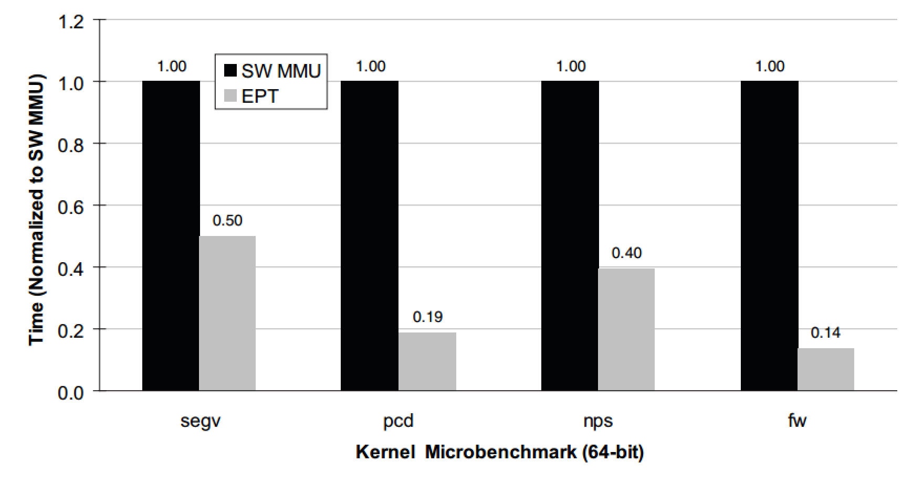
EPT Performance Evaluation
Microbenchmarks by the VMWare team
Normalized to shadow page table speeds (1.0)
  Lower times are better

Slide 54
Configuring Your VMM
Advanced VMMs like VMWare give you three options
  Binary translation + shadow page tables
  AMD-V/VT-x + shadow page tables
  AMD-V/VT-x + RVI/EPT
Which is best?
  Choosing between 1 and 2 is more difficult
  For some workloads, 2 is much slower than 1
  Run benchmarks with your workload before decided on 1 or 2
Fastest by far
But, requires very recent, expensive CPUs

Slide 55
Full Virtualization (VMWare)
Hardware Support
Paravirtualization (Xen)

Slide 56
The Story so Far…
We have discussed full virtualization by looking at the implementation of VMWare
We have discussed how recent advances in x86 hardware can speed up virtualization
Thus far, we have abided by virtualization rule #1:
  Fidelity: software on the VMM executes identically to its execution on hardware
What if we relax this assumption?

Slide 57
Relaxing Assumptions
Problem: it takes a lot of work to virtualize an arbitrary guest OS
  VMM implementation is very complicated
  Even with hardware support, performance issues remain
What if we require that guests be modified to run in the VMM
  How much work is it to modify guests to “cooperate” with the VMM?
  Will VMM implementation be simpler?
  Can we get improved performance?

Slide 58
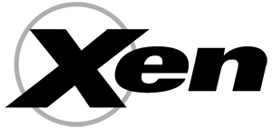
Paravirtualization
Denali and Xen pioneered the idea of paravirtualization
  Require that guests be modified to run on the VMM
  Replace privileged operations with hypercalls to the hypervisor
  Defer most memory management to the VMM
Our discussion will focus on Xen
  Commercial product owned by Citrix (i.e. GoToMeeting)
  Robust, mature hypervisor

Slide 59
Hypercalls
The Xen VMM exports a hypercall API
  Methods replace privileged instructions offered by the hardware
    E.g halt CPU, enable/disable interrupts, install page table
  Guest OS can detect if it’s running directly on hardware or on Xen
    In the former case, typical ring 0 behavior is used
    In the latter case, hypercalls are used
If a guest executes a privileged instruction, crash it
  Xen VMM makes no attempt to emulate privileged instructions
  Simplifies Xen VMM implementation

Slide 60
Handling Interrupts and Exceptions
Guests register callbacks with the Xen VMM to receive interrupts and exceptions
  Timer interrupts
  Page faults
  I/O interrupts
Xen buffers many events and passes them to the guest in batches
  Improves performance by reducing the number of VMM→guest context switches
In some cases, interrupts are forwarded directly to the guest without Xen’s intervention
  Example: int 0x80 system calls

Slide 61
Managing Virtual Memory
All guest memory is managed by Xen
  Guests allocate empty page tables, registers them with Xen via a hypercall
  Guest may read but not write page tables
  All updates to pages must be made via hypercalls
Advantages:
  No extra memory needed for extended page tables
  No need to implement shadow page tables
  No additional overhead for TLB misses
  No hidden misses
Disadvantages:
  Each updates to page tables cause a guest→VMM context switch

Slide 62
Virtual Time in Xen
Keeping track of time is hard in the guest
  Guest cannot observe CPU ticks directly
  VMM may context switch a guest out for an arbitrary amount of time
Xen provides multiple times to guests
  Real time: ticks since bootup
  Virtual time: ticks during which the guest is active
  Wall clock time, adjusted by timezone
Why are real time and wall clock time separate?
  The host OS may change the time (e.g. daylight savings)
  Changing the clock can cause weird anomalies

Slide 63
Virtual Devices in Xen
Xen exports simple, idealized virtual devices to guests
  Guest needs to be modified to include drivers for these devices
  Thankfully, the drivers are simply to write
This is essentially the same approach used by other hypervisors (VMWare, etc.)

Slide 64
Modifying Guests
How much work does it take to modify a guest OS to run on Xen?
  Linux: 3000 lines (1.36% of the kernel)
    Including device drivers
  Windows XP: 4620 lines (0.04% of the kernel)
    Device drivers add another few hundred lines of code
Modification isn’t trivial, but its certainly doable

Slide 65
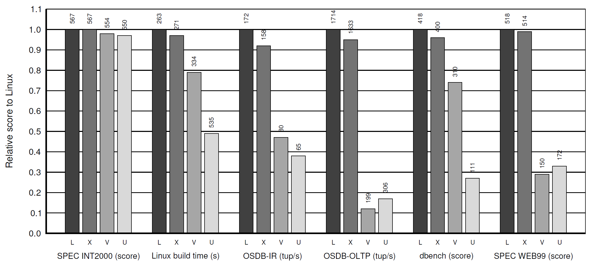
Xen Performance
Warning: this comparison is Xen vs. VMWare 3.2 in 2003
AMD-V/VT-x and RVI/EPT did not exist in 2003
Today, VMWare is much faster due to x86 hardware extension
Relative performance of native Linux (L), Linux on Xen (X), Linux on VMWare 3.2 (V), and User-Mode Linux (U)
Normalized to native Linux

Slide 66
Wrap-Up
Virtualization has made a huge resurgence in the last 15 years
Today, all OSes and most CPUs have direct support for hosting virtual machines, or becoming virtualized
Virtualization underpins the cloud
  E.g. Amazon EC2 rents virtual machines at low costs
  Hugely important for innovation

Slide 67
Bibliography
Software and Hardware Techniques for x86 Virtualization
  http://www.vmware.com/files/pdf/software_hardware_tech_x86_virt.pdf
A Comparison of Software and Hardware Techniques for x86 Virtualization
  http://dl.acm.org/citation.cfm?id=1168860
Performance Evaluation of Intel EPT Hardware Assist
  http://www.vmware.com/pdf/Perf_ESX_Intel-EPT-eval.pdf
Xen and the Art of Virtualization
  http://dl.acm.org/citation.cfm?id=945462

